Slide 2
YMCA Awards
Level 2 Dietary Needs of Different Groups

Slide 3
Session aims
Identify different groups with specific dietary needs to include vegetarian and vegan
Identify how religious or cultural beliefs can influence food intake
Explain how other factors may impact on dietary needs

Slide 4
Vegetarian and vegan
Vegetarian
An individual who (for ethical or moral reasons, or for reasons of personal choice) chooses not to eat meat, fish, poultry or animal products. Some vegetarians may eat eggs and dairy products
Vegan
As above (vegetarian), this list also extends to dairy products and eggs.

Slide 5
Religion and culture
Many religions/cultures follow dietary practices such as:
Abstinence
Fasting
Restriction of food
Rules on food preparation,
The above may affect their food selection.

Slide 6
Additional factors to consider
Medical conditions
Loss of appetite
More protein may be required to build and repair
Individuals may need more than the Recommended Daily Amount (RDA)
A dieticians role is to evaluate these dietary needs.

Slide 7
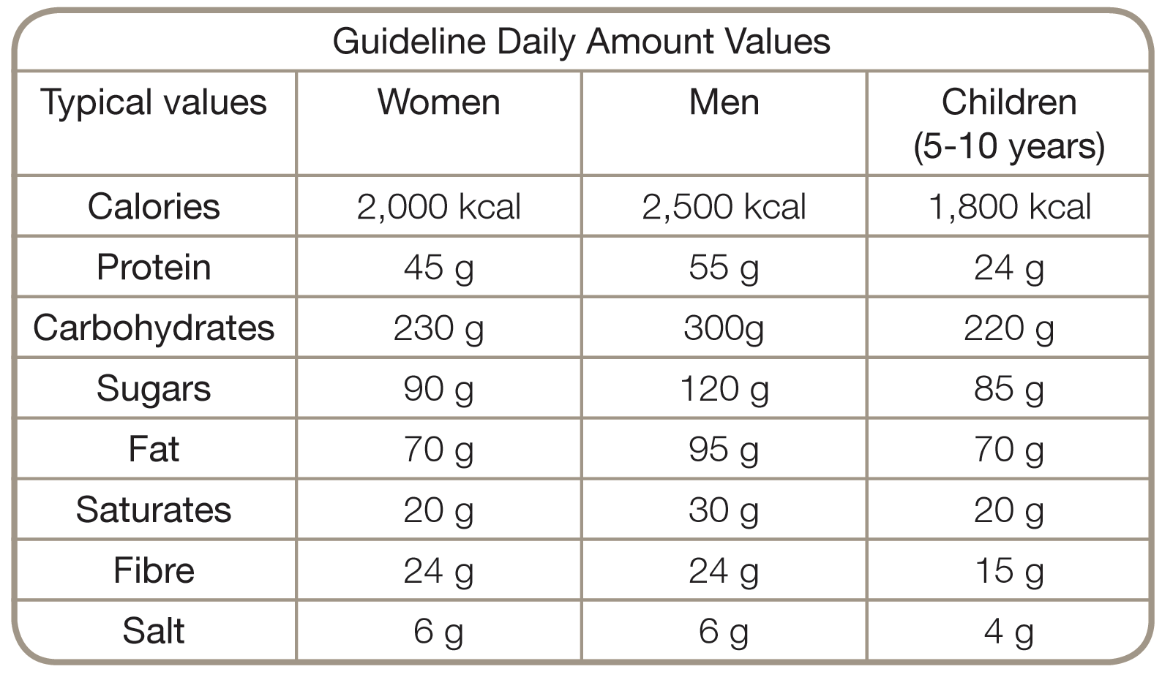
Age

Slide 8
Activity levels
Individuals who have an active job will require more energy
Individuals who exercise regularly may require more energy
The proportion of the food groups would stay they same, but their plate would be bigger.

